Slide 1
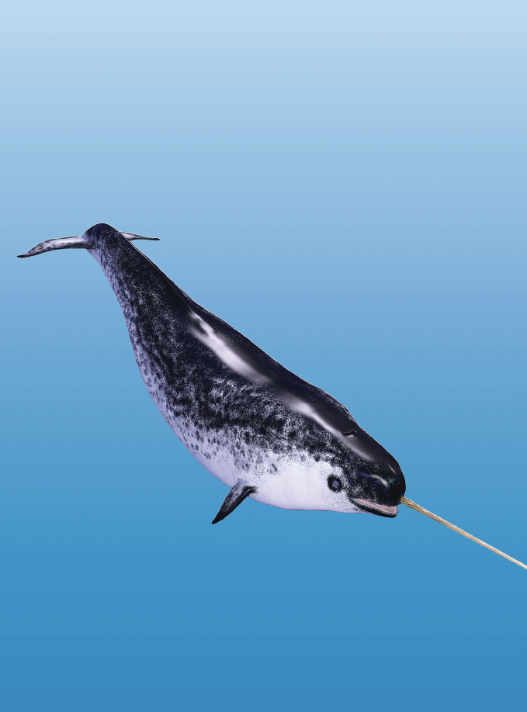
Teaching Resources and Instructors’ Guidelines
Chapter 12: Promoting entrepreneurship and new ventures

Slide 2
Chapter 12: Promoting entrepreneurship and new ventures
In the following PowerPoint slides you will find the key headings from CHAPTER 12 together with the main illustrations, tables, etc.
There are also slides summarizing the key messages in bullet-point fashion, and a wide range of activities which you can use to help students explore around these themes.
Finally there are some reflection questions which can be used as the basis for discussion or assignments.

Slide 3
Learning objectives
After this chapter you should be able to:
• Identify the individual and contextual factors which influence the creation of new ventures.
• Understand the process of creating an innovative new venture.
• Distinguish the challenges of each of the stages of new venture development.
• Understand the motives and management of corporate ventures
• Identify the advantages and drawbacks of different structures for corporate ventures

Slide 4

Core themes and material from the book

Slide 5
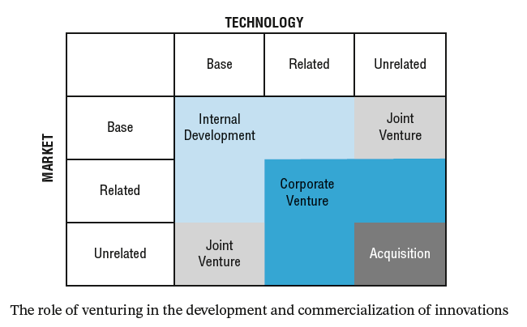
Options in venturing

Slide 6

Motives for starting new ventures
Lifestyle entrepreneurs
Growth entrepreneurs
Innovative entrepreneurs
Socially-motivated entrepreneurs

Slide 7
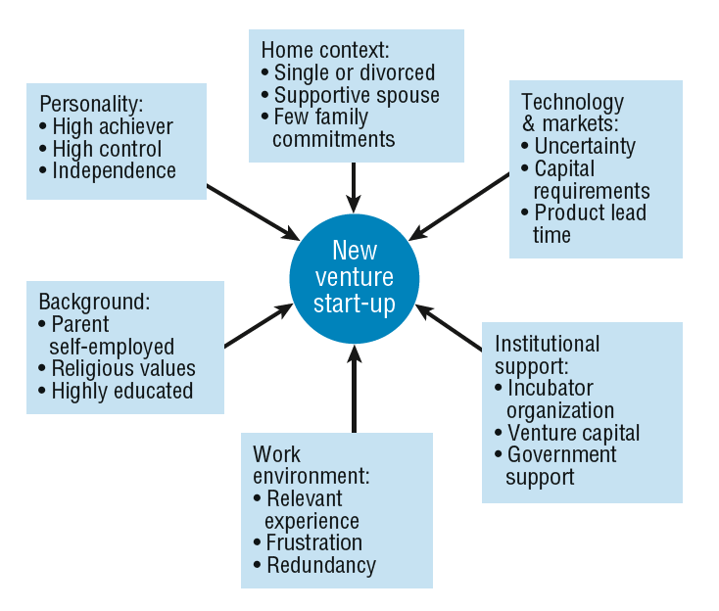
Influential factors

Slide 8

Motives for corporate venturing
• Grow the business.
• Exploit underutilized resources.
• Introduce pressure on internal suppliers.
• Divest non-core activities.
• Satisfy managers’ ambitions.
• Spread the risk and cost of product development.

Slide 9
Motives for corporate venturing
Combat cyclical demands of mainstream activities.
Learn about the process of venturing.
Diversify the business.
Develop new technological or market competencies.

Slide 10
Combat cyclical demand
Boeing set up two groups, Boeing Technology Services (BTS) and Boeing Associated Products (BAP), specifically with the function of keeping engineering and laboratory resources more fully employed when its own requirements waned between major development programmes.

Slide 11
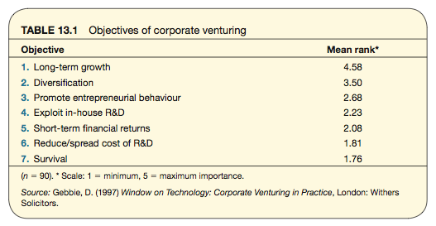
Reported motives for diversification

Slide 12
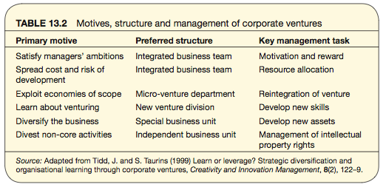
Motives, structure and management of CVs

Slide 13
Options in setting up ventures
Two critical dimensions for managing ventures:
Who owns them?
Who funds them?
Four possible options:
Opportunistic
Enabling
Advocacy
Producer

Slide 14
Establishing a CV – definition phase
Establish an environment that encourages the generation of new ideas and the identification of new opportunities, and establish a process for managing entrepreneurial activity.
Select and evaluate opportunities for new ventures, and select managers to implement the venturing programme.
Develop a business plan for the new venture, decide the best location and organization of the venture and begin operations.

Slide 15
Establishing a CV – development phase
Monitor the development of the venture and venturing process.
Champion the new venture as it grows and becomes institutionalized within the corporation.
Learn from experience in order to improve the overall venturing process.

Slide 16
Options in conceptualization of CVs
Rely on R&D personnel to identify new business opportunities based on their technological developments (i.e. essentially a ‘technology-push’ approach).
Rely on marketing managers to identify opportunities, and direct the R&D staff into the appropriate development work (i.e. essentially a ‘market-pull’ approach).
Encourage marketing and R&D personnel to work together to identify opportunities.

Slide 17
Challenges facing corporate entrepreneurs
They must establish their legitimacy within the firm by convincing others of the importance and viability of the venture.
They are likely to be short of resources, but will have to compete internally against established and powerful departments and managers.
As advocates of change and innovation, they are likely to face at best organizational indifference and at worst hostile attacks.

Slide 18
Key roles of
corporate entrepreneurs
technical innovator – responsible for the main technological development
business innovator or venture manager – responsible for the overall progress of the venture
product champion – promotes the venture through the early critical stages
executive champion or organizational champion – acts as a protector and buffer between the corporation and venture
high-level executive – responsible for evaluating, monitoring and authorizing resources for the venture, but not the operation of specific ventures.

Slide 19
Checklist for matching proximity and competencies
• What are the key capabilities required for the venture?
Where, how and when is the firm going to acquire the capabilities, and at what cost?
• How will these new capabilities affect current capabilities?
• Where else could they be exploited?
• Who else would be able to do this, perhaps better?

Slide 20
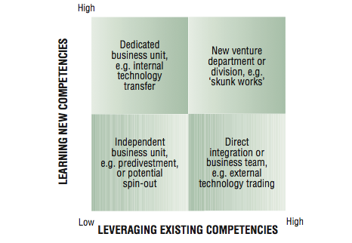
Leveraging competencies

Slide 21
Design options for CVs
• direct integration with existing business
• integrated business teams
• a dedicated staff function to support efforts company-wide
• a separate corporate venturing unit, department or division
• divestment and spin-off.

Slide 22
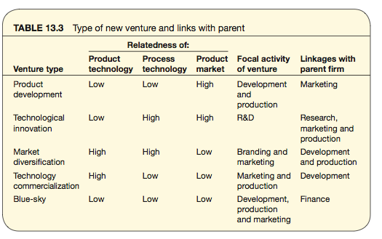
Linking new ventures with parents

Slide 23
Reasons for establishing a new venture
An effort to bring existing technologies and expertise throughout the company together for adaptation to new or existing markets.
To combine research from different fields or locations, to accelerate the development of new products.
To purchase or acquire expertise currently outside of the business for application to internal operations, or to assist new developments.
To examine new market areas as potential targets for existing or adapted products within the current portfolio.

Slide 24
Benefits of independent business units
Defrayed risk for parent, greater freedom for venture.
Less supervisory requirement for parent, less interference for venture.
Reduced management distraction for parent, and greater focus for venture.
Continued share of financial returns for parent, greater commitment from managers of the venture.
Potential for flow-back, process improvements or product developments for parent, and learning for the venture.

Slide 25
Strategic impact of new ventures
A study of 35 spin-offs from Xerox over a period of 22 years reveals that the aggregate market value of these spin- offs exceeded those of the parent by a factor of two by 2001, and by a factor of five at the peak of the previous stock market bubble.

Slide 26
Reasons for forming spin-out ventures
No existing company is ready or able to take on the project on a licensing basis.
The invention consists of a portfolio of products or is an ‘enabling technology’ capable of application in a number of fields.
The inventors have a strong preference for forming a company and are prepared to invest their time, effort and money in a start-up.

Slide 27
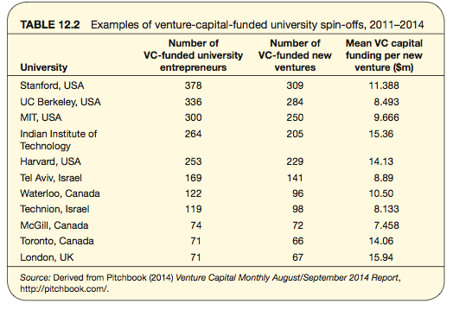
Examples of spin-offs

Slide 28
Motives for launching depend on...
Antecedent influences. Often called the ‘characteristics’ of the entrepreneur, including genetic factors, family influences, educational choices and previous career experiences, all contribute to the entrepreneur’s decision to start a venture.
Individual incubator experiences. Immediately prior to start-up include the nature of the physical location, the type of skills and knowledge acquired, contact with possible fellow founders, the type of new venture or small business experience gained.
Environmental factors. Include economic conditions, availability of venture capital, entrepreneurial role models, availability of support services.

Slide 29
Institutional variables in academic entrepreneurship
• Formal policy and support for entrepreneurial activity from management.
• Perceived seriousness of constraints to entrepreneurship, e.g. IPR issues.
• Incidence of successful commercialization, which demonstrates feasibility and provides role models.

Slide 30
Policy guidelines needed
specific guidelines on the use of university facilities, staff and students and IPR.
specific guidelines for, and periodic reviews of, the dual employment of scientist-entrepreneurs, including permanent part-time positions.
mechanisms to resolve issues of financial ownership and the allocation of research contracts between the university and the venture.

Slide 31
Innovative SMEs
are more likely to involve product innovation than process innovation
are focused on products for niche markets, rather than mass markets
will be more common amongst producers of final products, rather than producers of components
will frequently involve some form of external linkage
tend to be associated with growth in output and employment, but not necessarily profit.

Slide 32
Challenges for NTBFs
The first relates to long-term prospects for growth. Very few technology-based small firms can become superstars, since they provide mainly specialized ‘niche’ products with no obvious or spectacular synergies with other markets. How far the firm will grow, or how long it will survive, will often depend on its ability to negotiate the transition from the first to the second (improved) generation of products, and to develop the supporting managerial competencies.
How far the NTBF will grow depends on the second strategic choice: whether the management is aiming to maximize long-term value of the business or merely seeking an increase in income and independence. Thus, owners of small firms often sell their firms after a few years and live off their investments. And university researchers set up consultancy firms, either to increase their personal income (the BMW effect) or to find supplementary income for their university-based research and teaching activities in times of increasing financial stringency.

Slide 33
Summary
There are a wide range of motives for establishing corporate ventures, including to attract, motivate and retain talent, to grow the business, diversify or to develop and exploit new technological or market capabilities.
The best structure for a corporate venture depends on a number of factors, such as who owns and funds these, and the proximity of the technological or market capabilities to the core businesses.

Slide 34
Summary
The outcomes and success of corporate venturing should be assessed in broad terms, including the long-term survival, growth and evolution of the organization, rather than only by narrow financial evaluations of specific projects. It represents a process of corporate experimentation and evolution

Slide 35

Videos
There are several videos which can help explore and present the key themes of the chapter:
Tidewave is a start-up originally from the University of Stavanger in Norway and now growing into a successful business. This series of interviews explores the challenges facing the founders
Victor Cui and
Melissa Clark-Reynolds talk about setting up their new ventures
Catherina van Delden talks in this video about her start-up Innosabi and then reflects here about its current challenges now employing over 50 people
Notes:
Short videos

Slide 36
Media: Entrepreneurship
Follow the link below to watch a video by The School of Life on ‘How to be an Entrepreneur’
https://www.youtube.com/watch?v=lJjILQu2xM8

Slide 37
Media: Entrepreneurship
Follow the link below to watch Paul Tasner’s TED Talk, ‘How I became an entrepreneur at 66’
https://www.ted.com/talks/paul_tasner_how_i_became_an_entrepreneur_at_66/reading-list

Slide 38
Activities
There are a variety of activities (for both groups and individuals and for online as well as offline work. These include:

Slide 39
Activity: Corporate venturing
Tesco is a successful supermarket retailer. In order to grow it has tried expanding into new geographical markets. This case explores its attempt to move into the US market.
Using these resources and your own research, explore the ways in which Tesco approached this corporate venture and suggest reasons for its eventual pull out of the venture. What lessons could it learn about future moves of this kind?

Slide 40
Activity
You’ve been asked as consultants to recommend ways of enhancing innovation capability in an established business.. They already have effective ‘steady state’ capability– what else would you recommend? What structures and ‘routines’ do they need to:
  search beyond their lamp-post?
  handle the ‘immune system’ and persuade the company to do something very different?
  implement what may be alien ideas, incompatible with current skills, resources and a ‘how we do things around here’ culture?
Prepare a short feedback presentation to ‘the Board’

Slide 41
Cases
There are several case studies which highlight key themes in the chapter, including:
Tidewave, a detailed longitudinal study following from start-up through early stage growth
Espresso Mushroom, Aquapax, Brighton Beard Company, Luminaid as start-up ventures
The case of Spirit illustrates an entrepreneurial approach to exploiting dormant knowledge resources
Hella Ventures describes the process of setting up a corporate venture and some of the challenge sin its operation
The case study of radical change within Philips Lighting with some reflections by the change agent, Dorothea Seebode, on the process
The Gamechanger approach to corporate venturing used by Shell over many years.
The examples of Kodak and Fuji show how diversification takes place as they try to respond to the decline in their mainstream photography markets

Slide 42
Tools
There is a rich variety of tools to help with themes raised in the chapter You can find them on the website here.
Lean start-up
Business model Canvas
Entrepreneur’s storyboard
Entrepreneur’s audit
Decision matrix

Slide 43
Assessments and discussion questions
1. What options exist for corporate venturing? Discuss the relative strengths and weaknesses of different approaches.
2. Jim Smith has asked for your help since his company is in a declining market and using old technology. He feels they are ‘running out of road’ and wants to implement some form of corporate venturing approach to identify new options. What advice would you give him?

Slide 44
Assessments and discussion questions
3. Why would an organization consider corporate venturing? What motives might drive them in this direction?
4. What might the challenges be for a CV group set up to exploit the untapped knowledge base within an organization?

Slide 45
Assessment and discussion questions
5. What are the differences between corporate venturing and new product development?
6. In what ways could strategic and operational goals create conflicts?
7. What are the main management challenges in the relationships between the parent organization and its ventures?
8. What are the advantages and disadvantages of the different approaches to resourcing and structuring corporate ventures?

